Slide 1

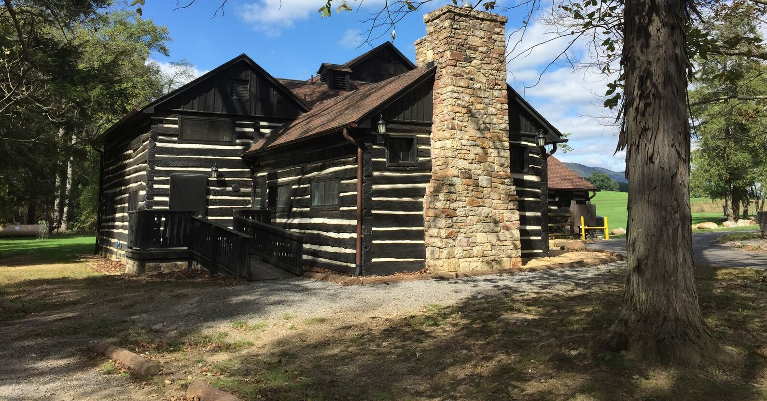


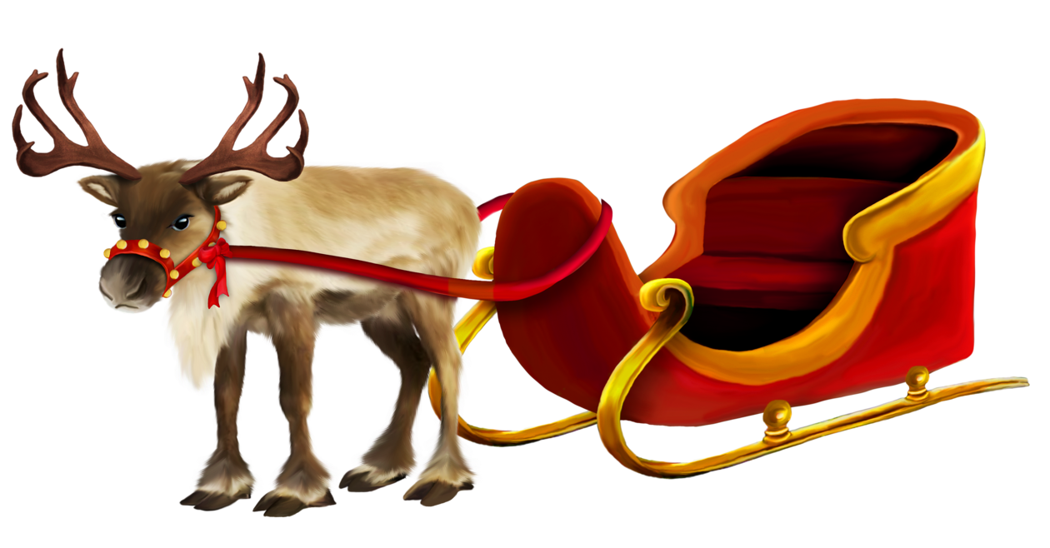
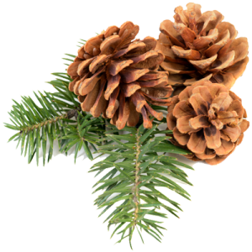
Christmas at Cacapon
Cacapon Resort State Park Christmas at The Old Inn
Saturday, December 17
10:00AM -12:00PM Pictures with Santa…Don’t forget a camera! While waiting for Mr. & Mrs. Claus a variety of Christmas ornament making stations & face painting too!
1:30PM Christmas Concert Songs by Doug & Darinda Sherbert followed by Old fashioned Christmas Carolling
Come and join us for a warm fire, Christmas decorations,
cookies and refreshments, and a fun time singing your favorite Christmas Carols with the musicians!

